Slide 1
New beginnings
A retreat
St Mary Magdalene, Langridge
6th September 2014

Slide 2
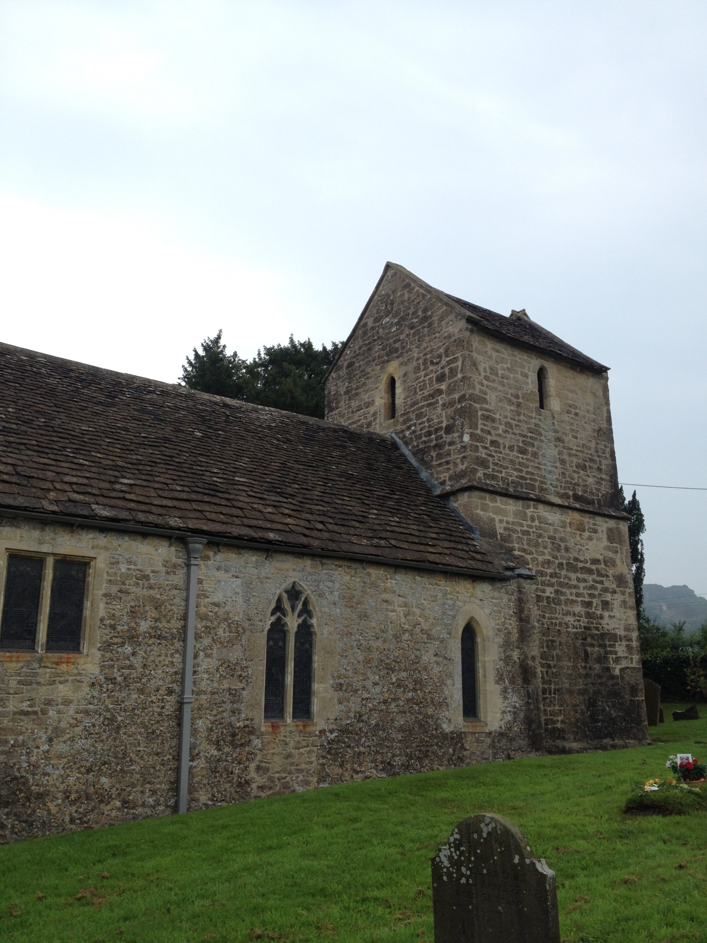

Slide 3
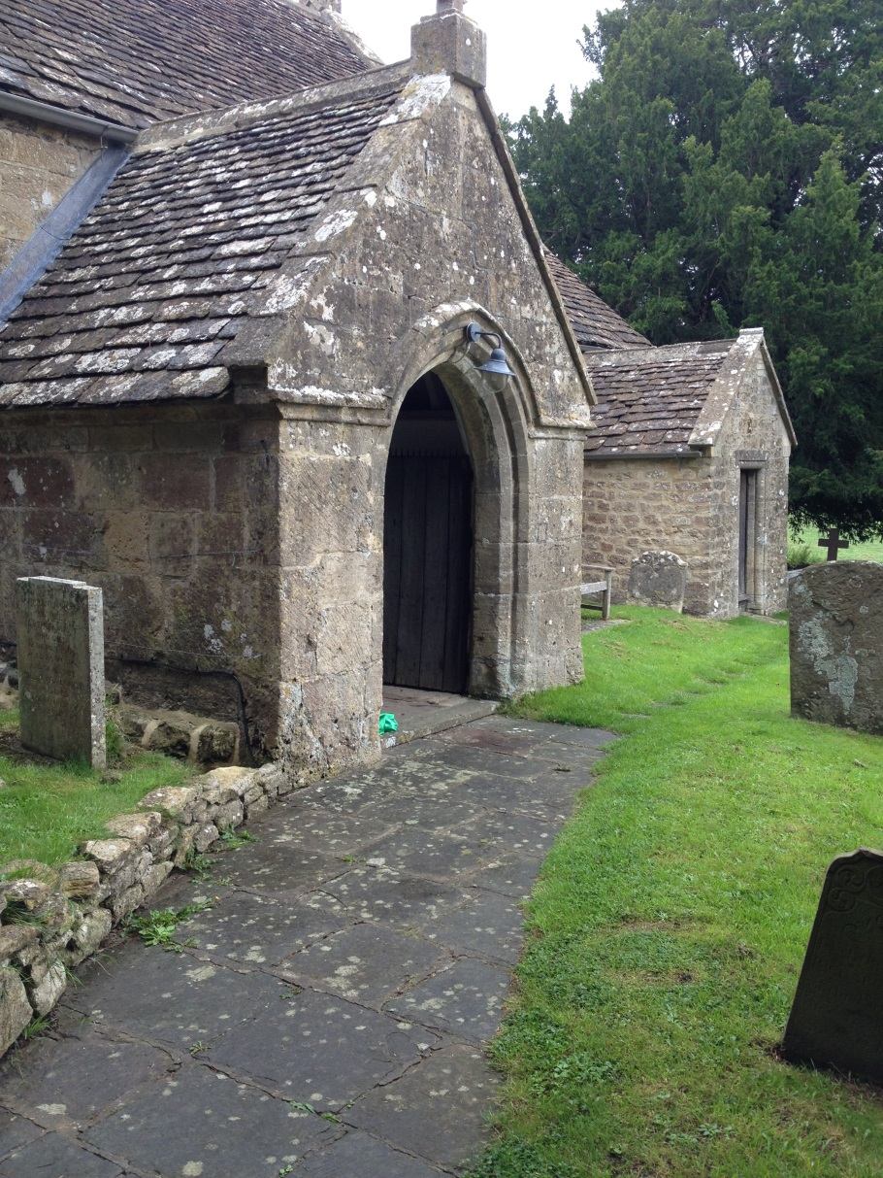
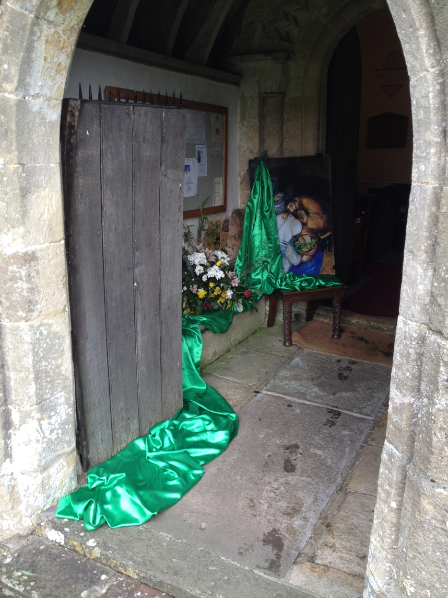

Slide 4
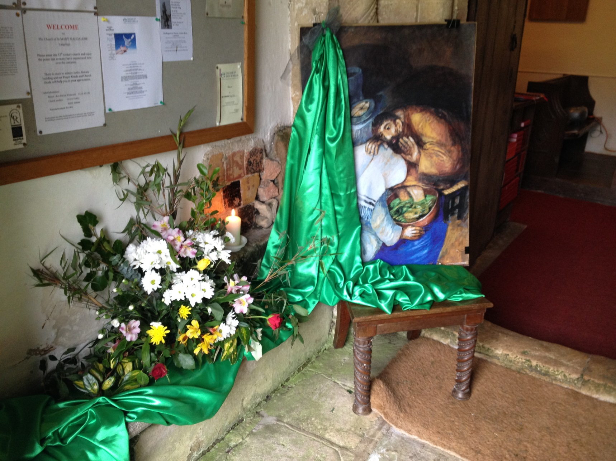
A station at the door – to pause and think

Slide 5
Jesus washing Peter’s feet
COME AND SEE
Come quietly
to this painting.
Give yourself time to look
and to become aware
Of the figures,
the colours,
the light and shadows
What first caught your eye?
Which colours drew your attention?
What most held your gaze?
What surprised you?
What puzzled you?
What was your first thought?
How do you feel after spending time with the picture?
Peter was reluctant for Jesus to wash his feet.
Why?
Was he afraid for Jesus to come so close
and to see and touch his wounded humanity;
and see and know him as he truly was.
What about us?
What about me?
How willing am I to allow Jesus so close,
to see and touch my wounded humanity?
What areas of my life, my experience, my woundedness
do I want to keep hidden from Jesus,
although he knows me better than I know myself already?
What areas of my life
need to be opened to the healing, purifying mercy of God?
What needs ‘washing’ in me?

Slide 6
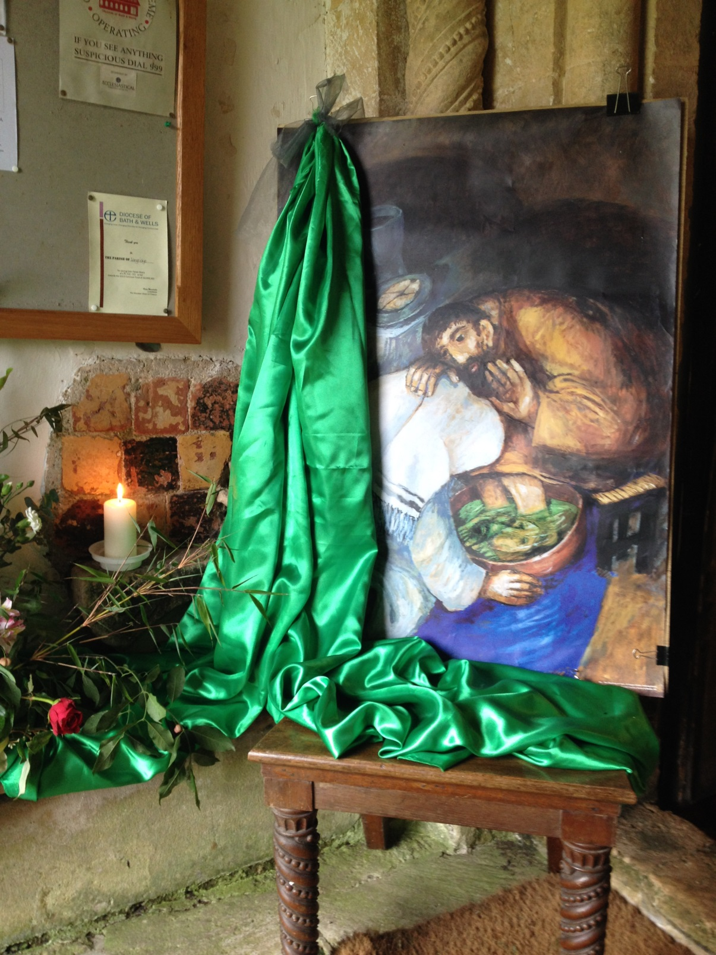
Lord not this bit…….?

Slide 7
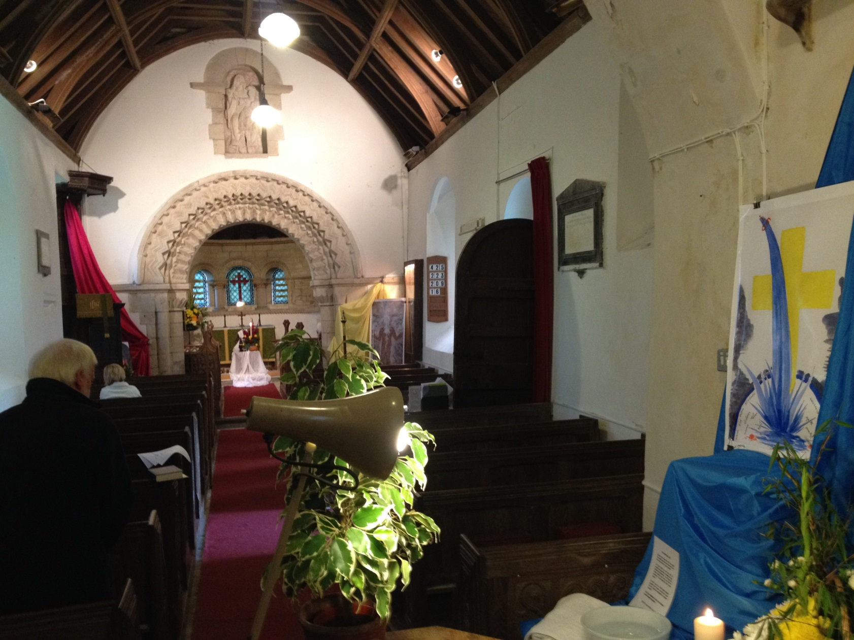
Four stations inside

Slide 8
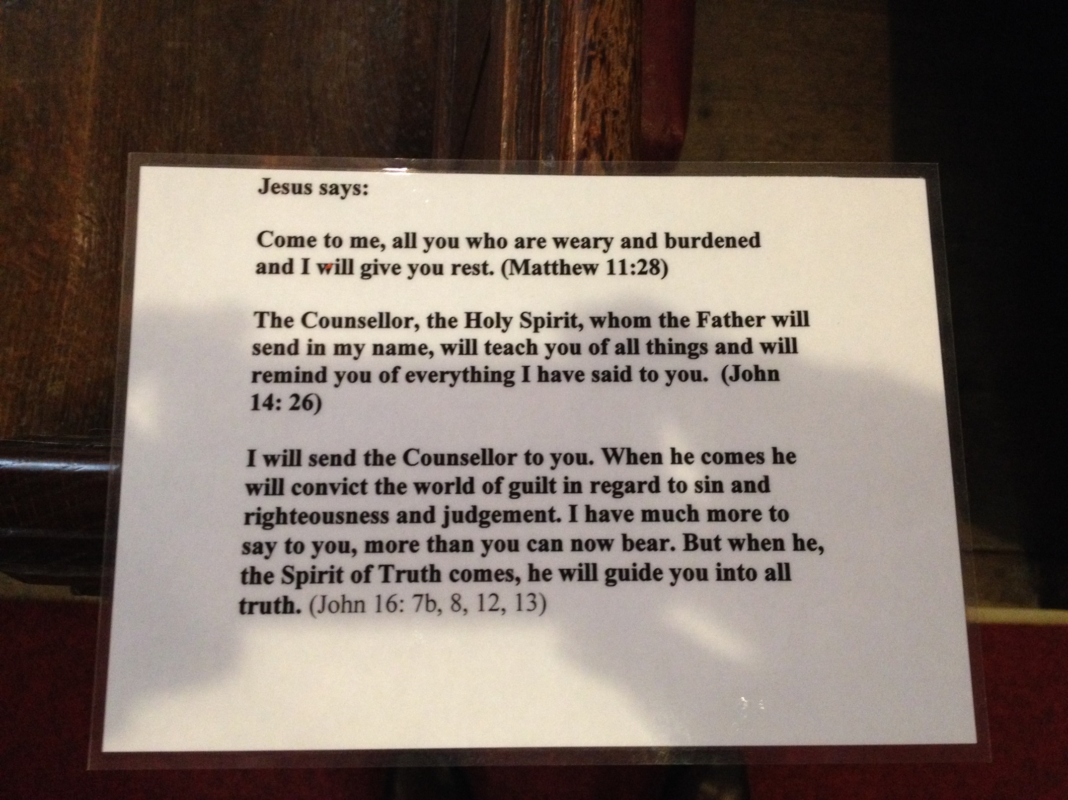

Slide 9
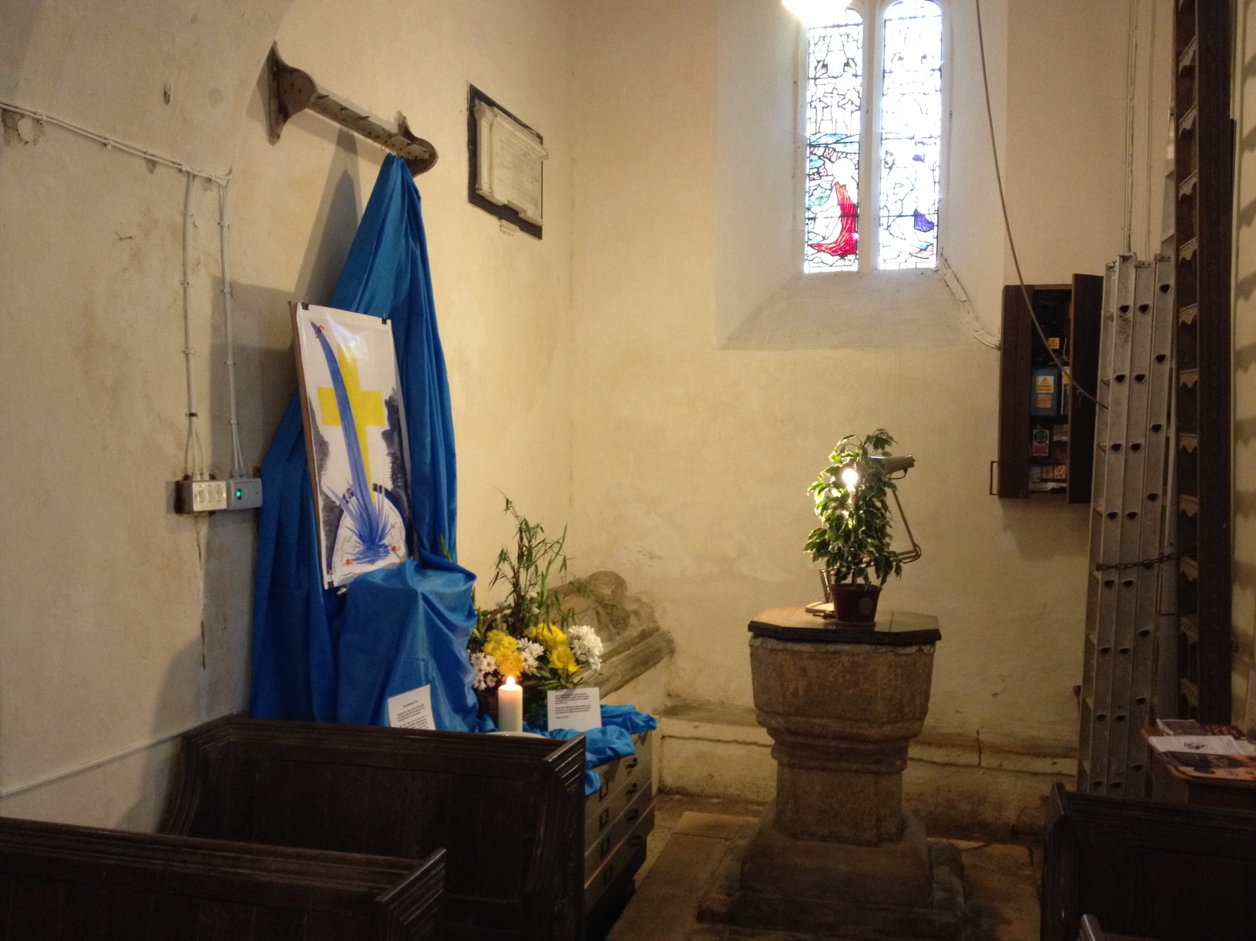
Pentecost blessing to our sick world

Slide 10
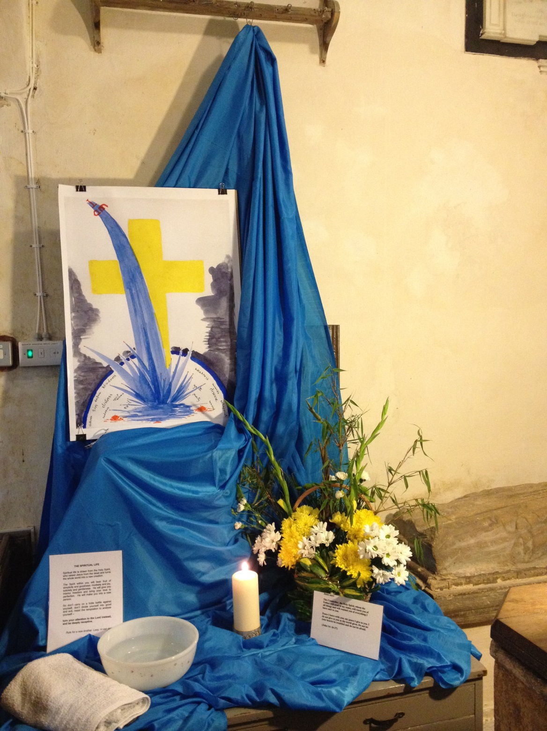
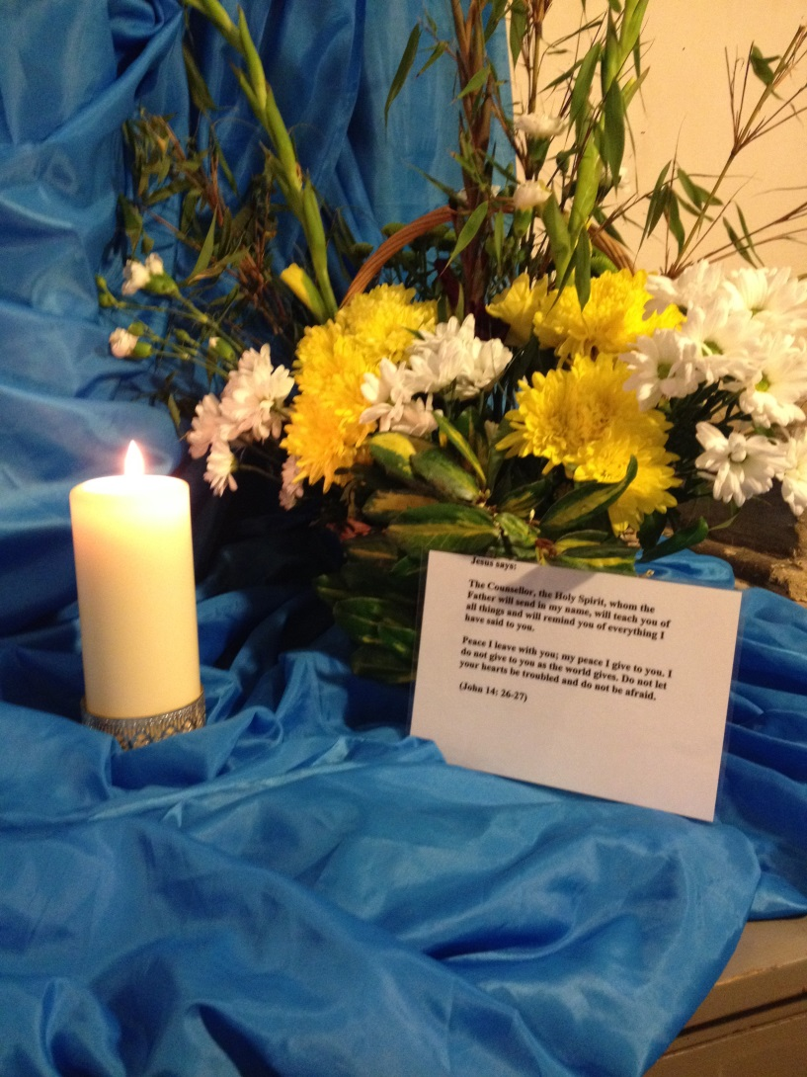

Slide 11
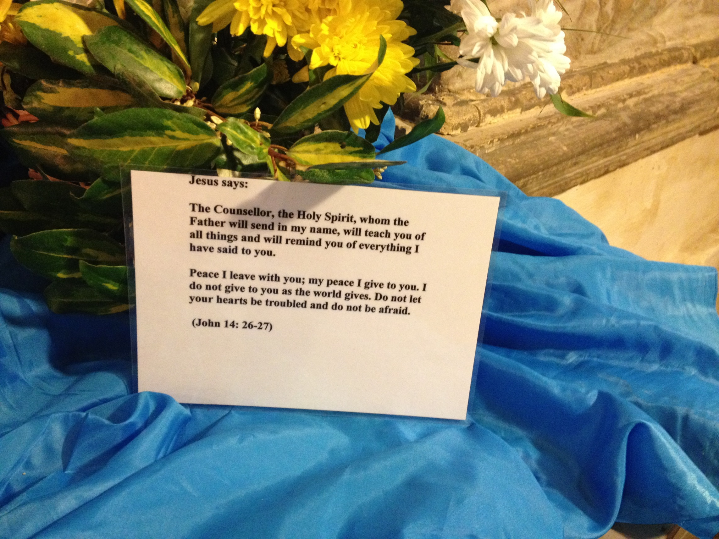

Slide 12
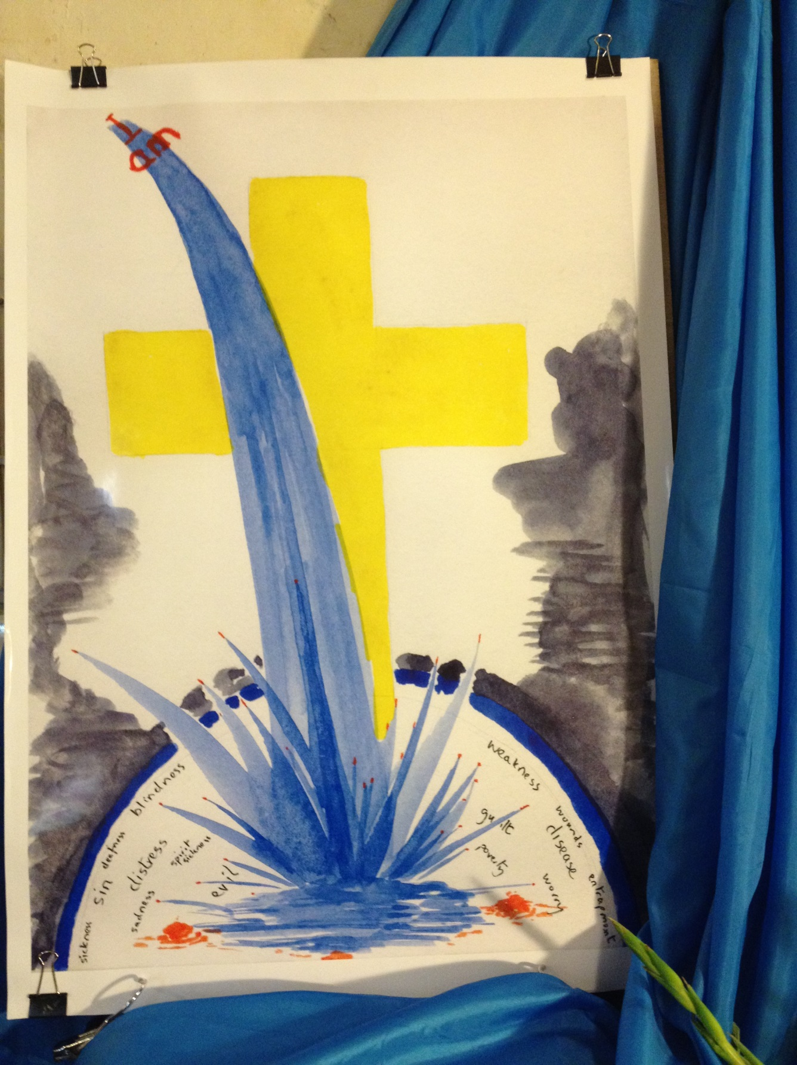

Slide 13
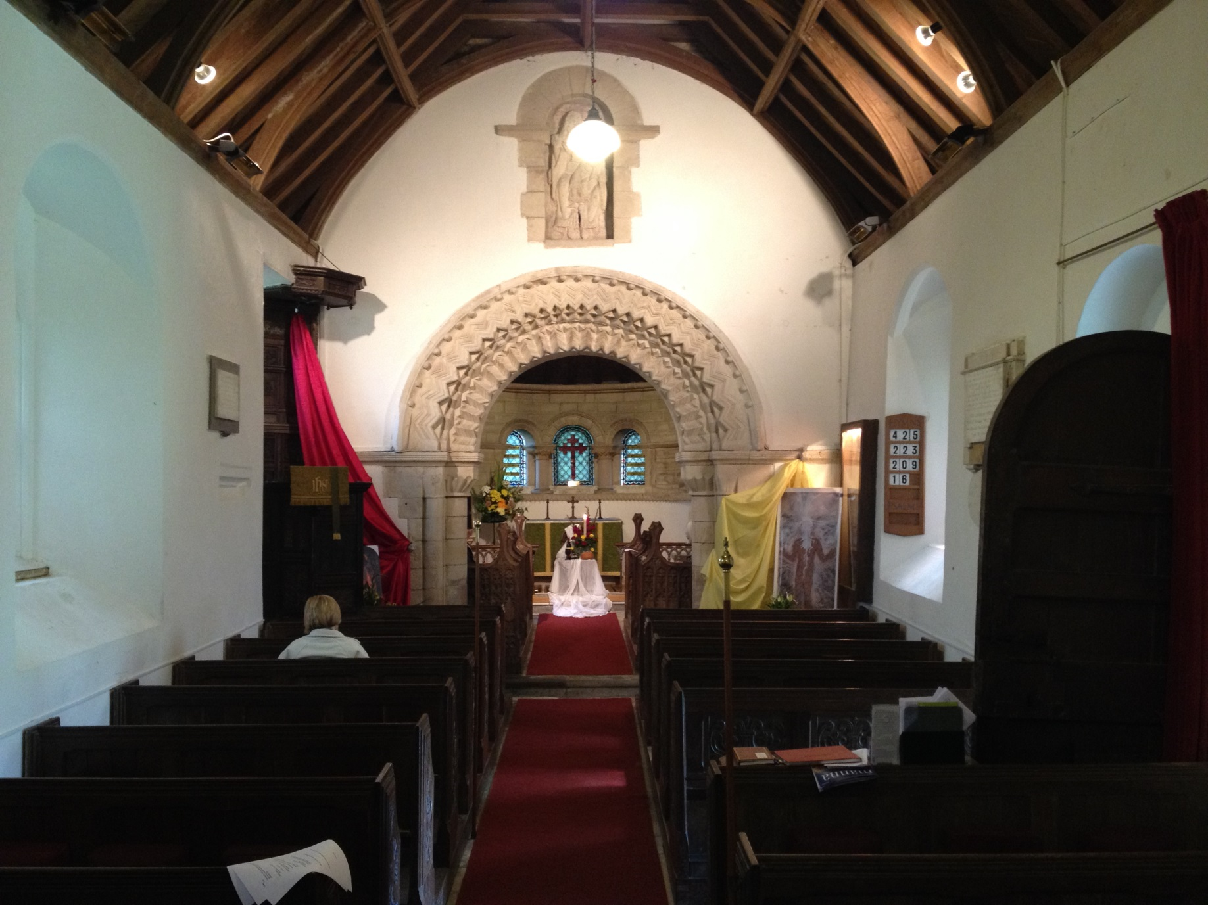
and then on……..

Slide 14
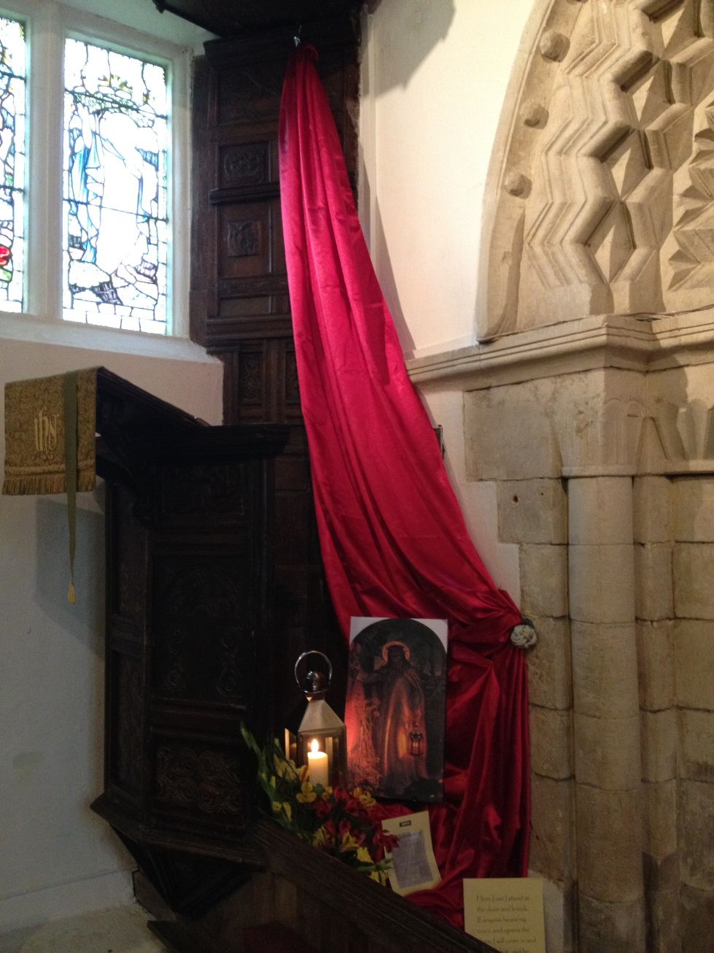
I am the light of the world. I stand at your door and knock (Rev 3: 20)

Slide 15
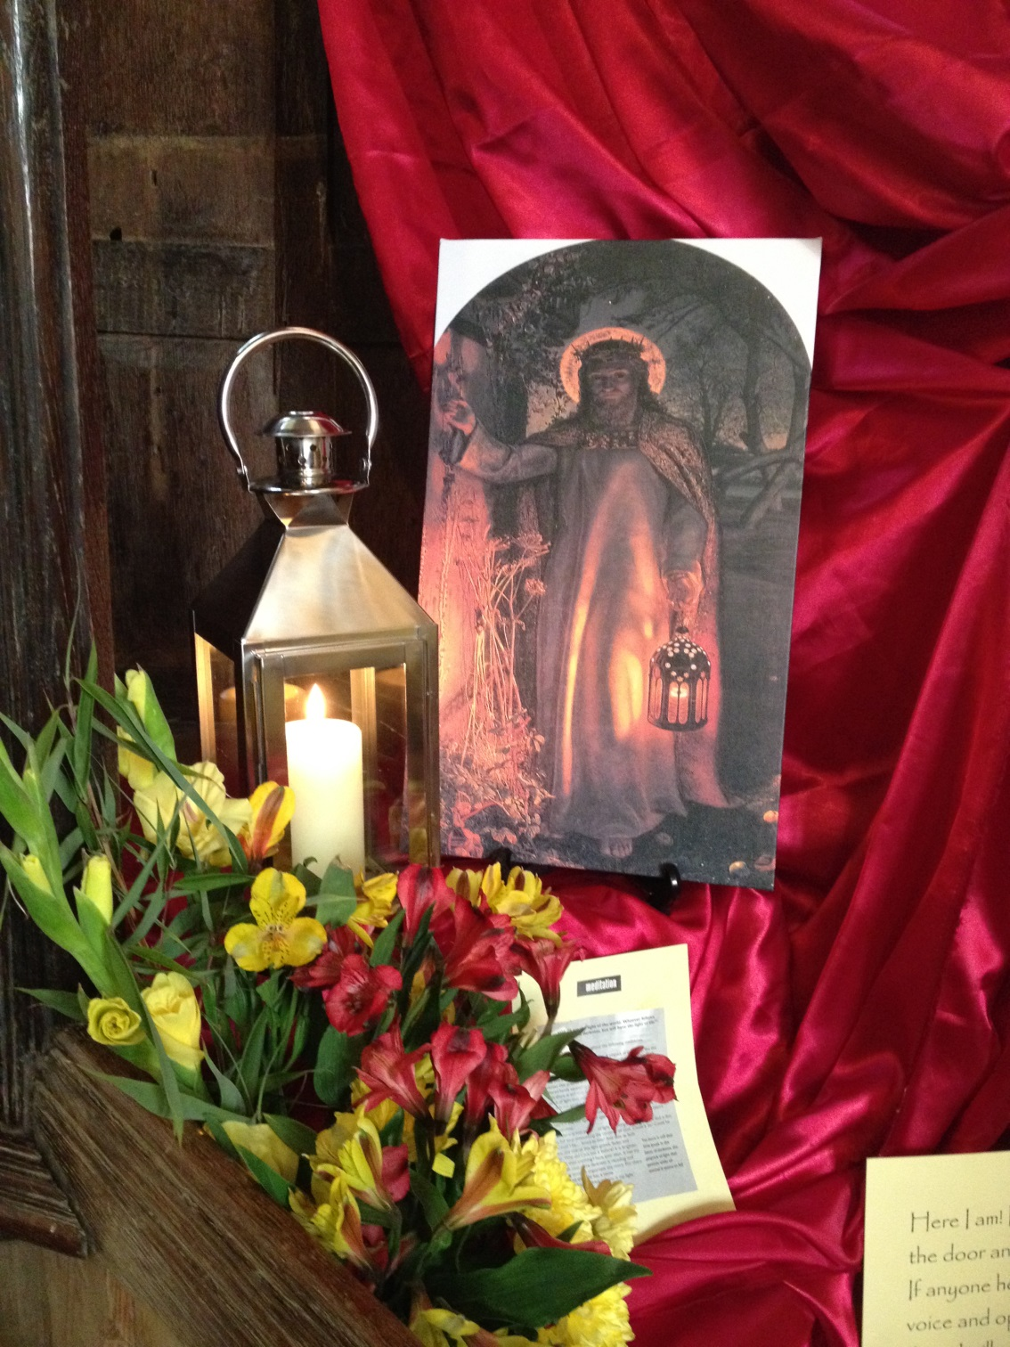
If you open the door I will come in and eat with you, and you with me

Slide 16
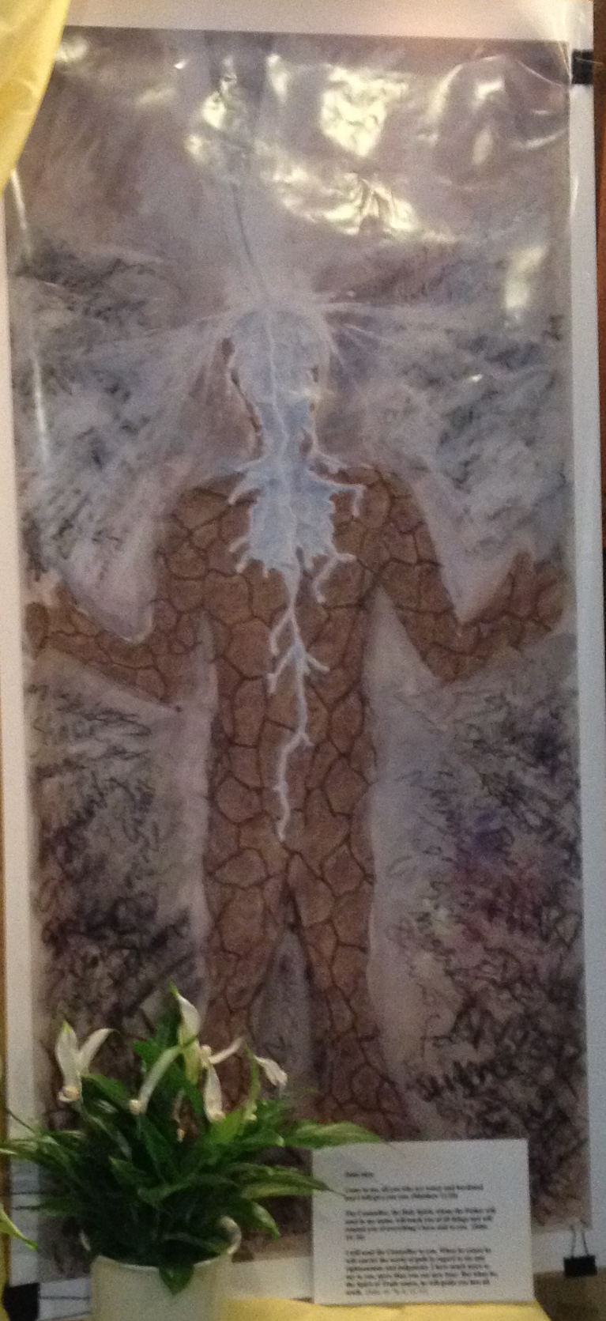
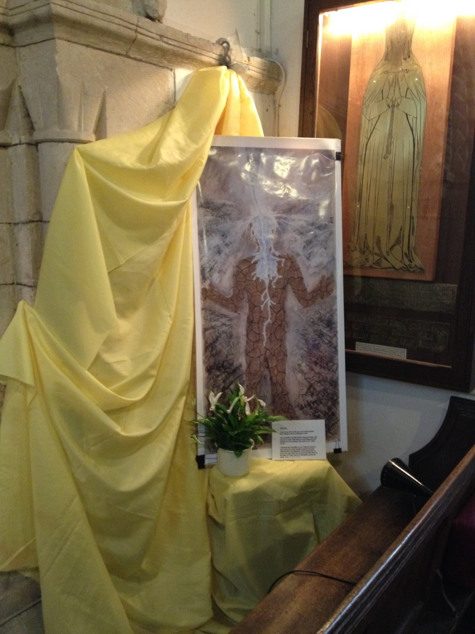
Cleansing water

Slide 17
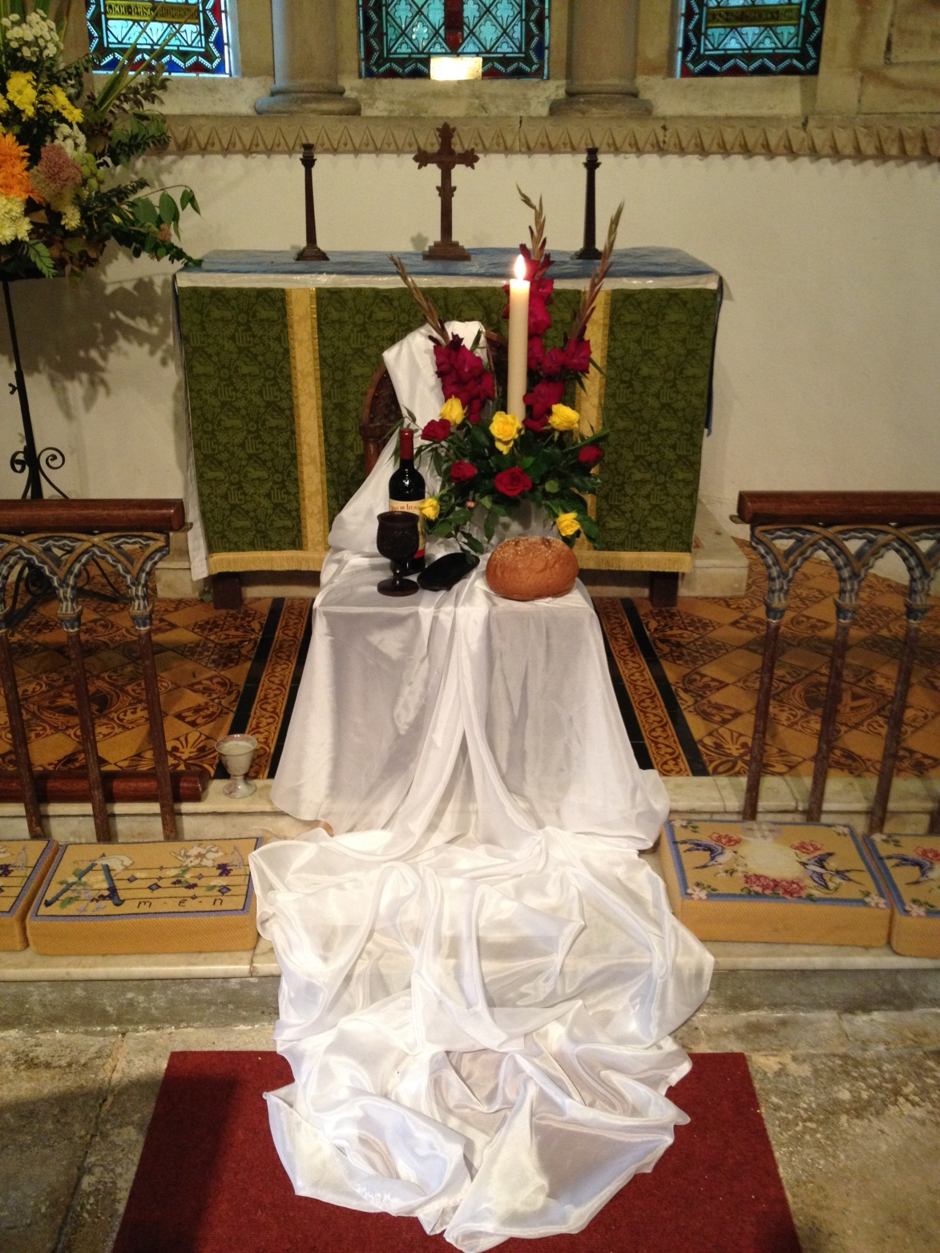
Do this in remembrance
of me

Slide 18
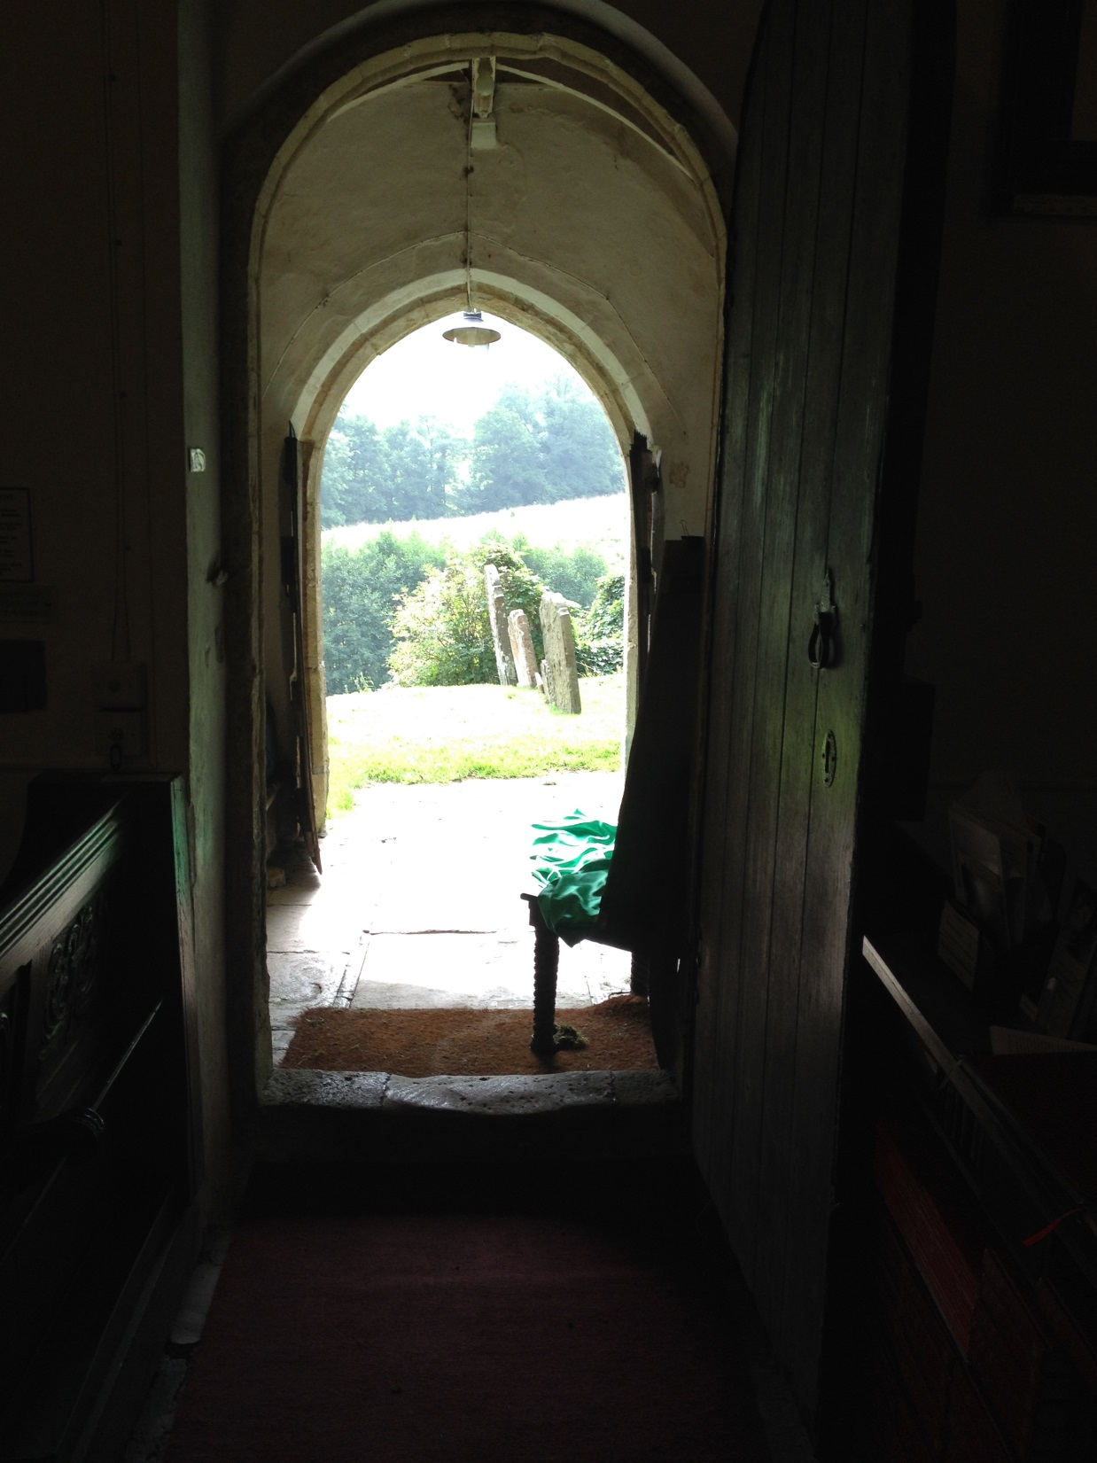
  And so on with the day

Slide 19
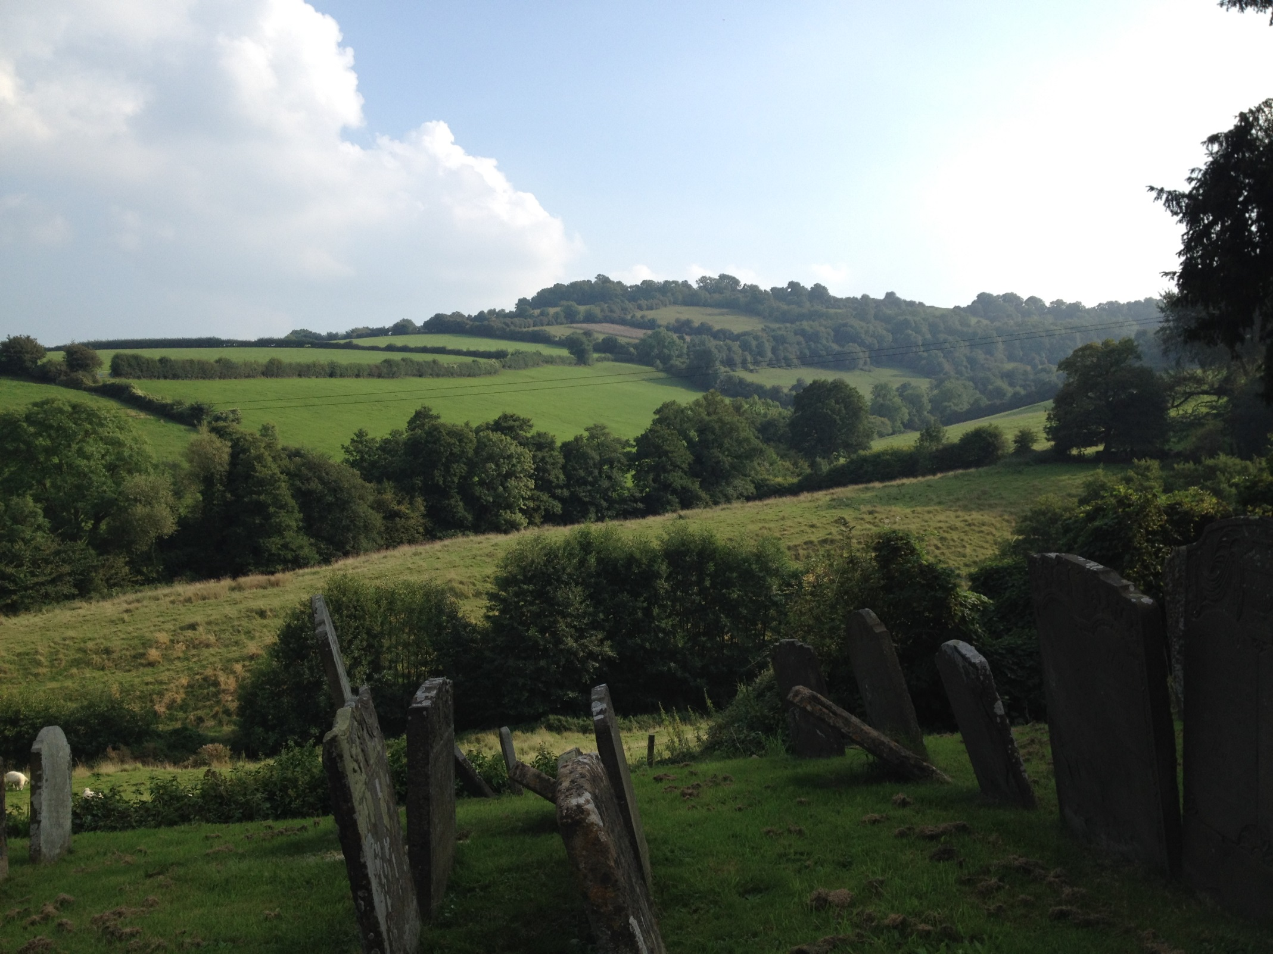

Slide 20
May the Lord bless you
St Mary Magdalene, Langridge is a Norman church NW of Bath, and linked with All Saints Church, Weston.
For more information about Langridge church please visit: http://www.stmarymagdalenelangridge.com/
For more information about ASW please visit
http://www.allsaintsonline.org.uk/

